Slide 1
Continuing Professional Development for Teacher-Educators CPDC Introduction to Learning Resources CPDC Development Team
In association with the National Commission for Colleges of Education, Abuja
August 2015

Slide 2
REFLECTION
Activity 1
Consider the following resource materials. What subject areas are these resource materials suitable for teaching?
(here, the facilitator will bring different resource materials-both human and non-human into the classroom for brainstorming).
(Create a slide that contains the pictures above)
Activity 2
A chemistry teacher dictating to a class the processes and procedures that create a particular scientific result.
(create a video of a chemistry teacher teaching with out resources)
What practical help can the class get?

Slide 3
An Overview
Curriculum is primarily designed to equip learners with essential knowledge, skills and experiences to contribute to and function optimally in society. To achieve these goals, curriculum must conform to the new trends in teaching. One aspect of these trends is the use of learning resources in our classrooms to support more active learning. Therefore, this module explores various ways that Teacher-Educators can select learning resources to make their classrooms more interactive and to enhance efficient learning.

Slide 4
Overview
What are the assessment tasks?
What is the module about?
Knowing each other

Slide 5
Knowing each other
Overview of CPDC LR

Slide 6
Learning Resources
knowing each other
Break into pairs.
Each member of the pair should interview his/her colleague to find out:
His/her name
His/her subject(s)
His/her most meaningful teaching or learning experience.
When ready, each member of the pair introduces his/her partner to the rest of the group.

Slide 7
What is the module about?
Overview of CPDC LR

Slide 8
Activity for Teacher-Educators
Mention as many kinds of learning resources as you can.
Classify the learning resources listed using your own initiative.
Are 2D and 3D learning resources (LRs) mentioned in your list?
Why do we need learning resources in our classrooms?
Can you recall how frequently your own teachers used LRs in teaching you as a student?
Can you estimate how frequently you use LRs in your teaching?
What difference if any is there between your experience as a learner and your practice as a teacher?

Slide 9
Content
Why learning resources
Classification of learning resources
2D Learning resources
3D Learning resources
Selection of Learning resources

Slide 10
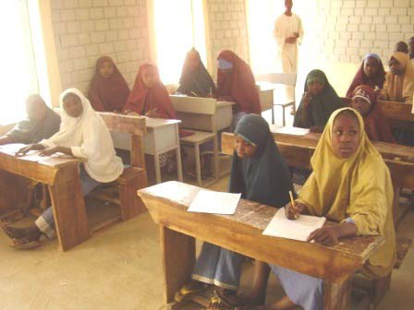
Why Learning Resources?

Slide 11
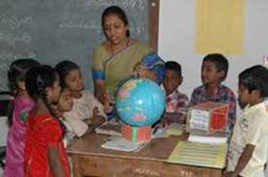
Why Learning Resources?

Slide 12
Group Discussion 1.What are learning resources? 2. What are the types of learning resources you can find in your environment? 3. How can you use them in the classroom? 4. What are the different learning resources that you know can be used in teaching a particular topic in your discipline? 5. What other ways do you know for sourcing learning resources? 6. Identify the guiding principles to be used in selecting, designing and utilizing learning resources.
Why Learning Resources (cont.)

Slide 13
Classification of Learning Resources
ipad, iphone, Handset, Computer, Power-Point Projector, Television etc. are all electronic learning resources. What other classes of learning resources can you identify?
Group the learning resources you have mentioned above into two broad categories.
From your broad list, classify the learning resources into four types.

Slide 14
What are the assessment tasks?
Overview of CPDC LR

Slide 15
Assessment tasks
Reflection on prior knowledge and experience regarding learning resources
Planning for integration of learning resources
Teaching using learning resources and reflecting critically on the experience
Assessed by a competency rubric

